Slide 1

Interactive Sales Dashboard
An Overview of Key Business Insights

Slide 2
Sales Performance Overview
Analyzing sales data for informed business decisions
Visualize company performance,
Utilizing sales data to create a clear and engaging visual representation of overall business performance, aiding in immediate understanding of key metrics.
Informed business decisions,
Empowering stakeholders with essential insights derived from data analysis, facilitating strategic planning and decision-making processes.
Focus on Sales and Profit,
Highlighting critical aspects of sales and profit analysis to evaluate the effectiveness of business strategies and identify growth opportunities.
Product Performance insights,
Examining the success of various products to identify best-sellers and underperformers, driving product strategy and marketing efforts.
Geographical Insights,
Analyzing sales data by location to uncover market trends and tailor strategies for different regions, enhancing customer targeting.
Time-based Trends,
Understanding how sales fluctuate over time, which helps in forecasting and strategic planning based on historical data trends.

Slide 3
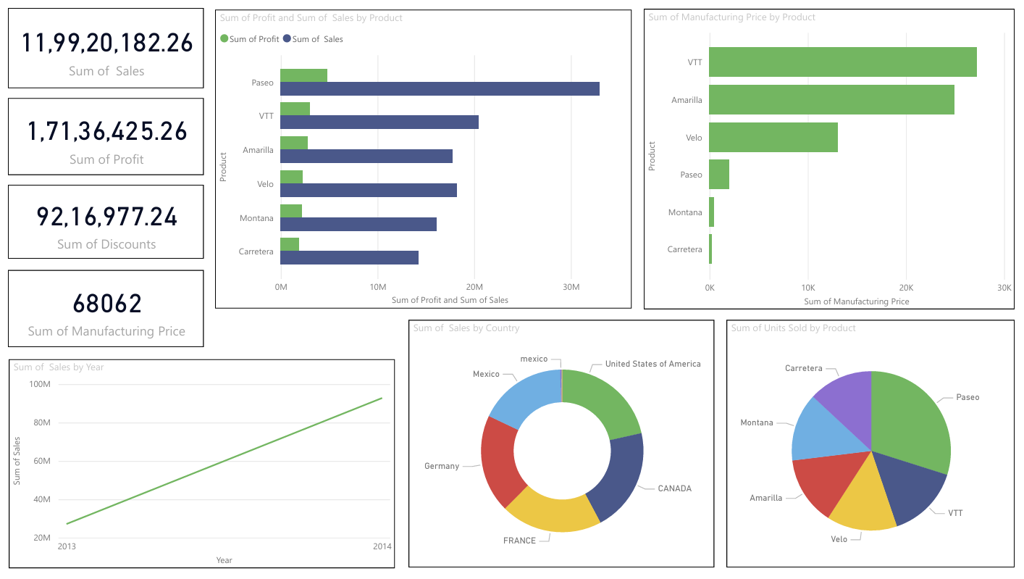

Slide 4
Dashboard Summary: Sales Performance Analysis
Overview,
This interactive dashboard provides a comprehensive analysis of the company’s sales, profit, product performance, and market reach, helping stakeholders make data-driven decisions
Key Metrics (KPIs) :
Total Sales: ₹11,99,20,182.26
Total Profit: ₹1,71,36,425.26
Total Discounts Given: ₹92,16,977.24
Total Manufacturing Price: ₹68,062
Insights from Visualizations :
Product Performance
Top Seller: Paseo, followed by VTT and Amarilla.
Paseo leads in sales; VTT has the highest manufacturing cost.
Units sold are fairly distributed, with Paseo leading.
Geographical Analysis
Top Markets: United States, Canada, and France.
Country-wise donut chart shows regional distribution of sales.
Time-Series Trend
Clear upward sales trend from 2013 to 2014, indicating business growth.
Stakeholder Insights
Identify best-selling products and optimize underperformers.
Analyze regional markets for targeted strategy.
Assess profitability vs manufacturing cost for product-level planning.
Understand yearly growth for forecasting and resource planning.
Dashboard Features :
Cards for totals (Sales, Profit, Discounts, Manufacturing Price)
Bar Charts to compare Sales & Profit by Product
Pie/Donut Charts for Country-wise Sales & Units Sold
Line Chart for Yearly Sales Trend
Consistent Color Theme for clarity
Optional Slicers (filters) can be added for interactivity

Slide 5
Thank You

